Slide 1
Git Architecture

Slide 2
Git Version Operations
Local machine
Remote server
workspace
Staging
Local Repository
Remote Repository
git add/mv/rm
git commit -m
git commit –a -m
git reset <file>
git push
git reset commit –hard /soft/ mixed
git fetch
git diff
git diff HEAD
git pull / clone

Slide 3
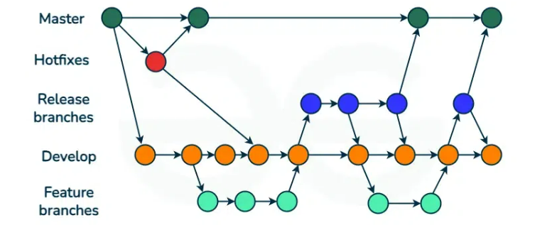
GitFlow – Branching and Merging
Master – holds stable production codebase
Development – ongoing development
Feature – branches off the development branch to develop new features.
Release –new production release and bug fixing, typically branched from the develop branch, merges back into both develop and master branches.
Hotfix – Hotfix branches helps in addressing bugs fixes, allowing developers to continue their work on the develop branch. Hotfix branches off the master branch and merges with Master after completion.

Slide 4
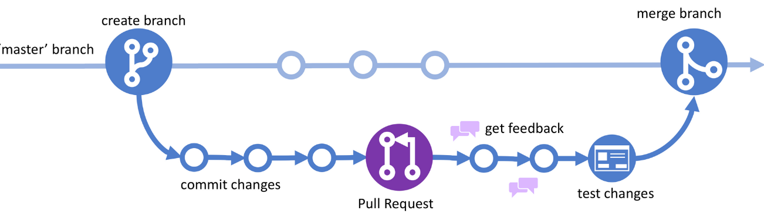
GitHub Flow
GitHub Flow branching strategy:
Master – The GitHub Flow workflow initiates with the master branch, hold the stable production code.
Feature – Developers initiate feature branches from the main branch to implement new features. Here development branch is absent.
The feature branch is merged back into the main branch.

Slide 5
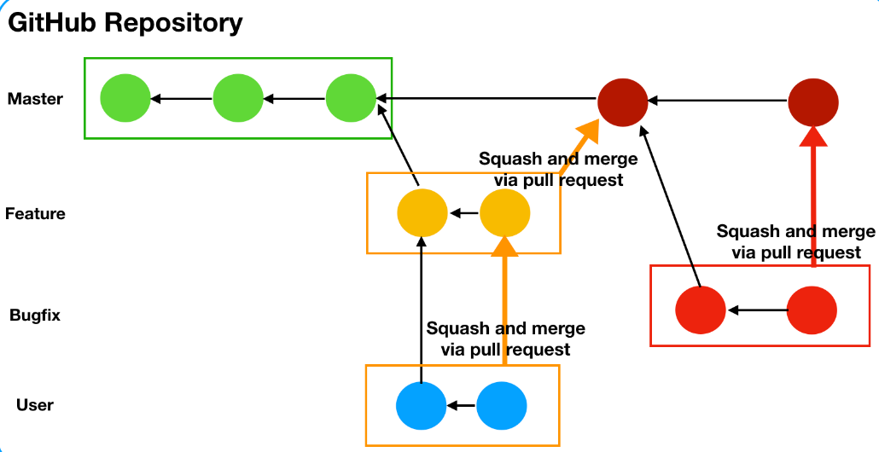
GitHub Flow explained

